Slide 1


How to host a
DSC Cloud Fest
Cloud Study Jams

Slide 2


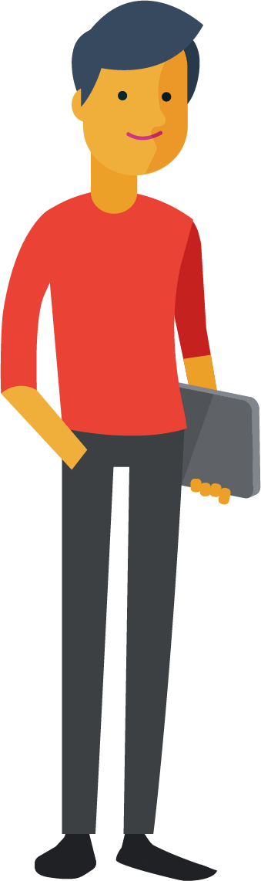

Taking you away from the puzzle world!
Planning & Hosting a
DSC Cloud Fest at your campus
Sometimes it may be a bit challenging to understand what you need to do as a DSC lead during these fests, but don’t worry!
You are going to be a Champion!
Never give up a chance to try & Experiment!

Slide 3





Path to Host Cloud Fest
Request for Qwiklabs credits
Be prepared, it’s important
Announce a Date
Keep them prepared
You are a Champion
Get feedback from the attendees
Deploy & Host!
Collaborate with other communities for better content
Roll out registration
Know your attendees

Slide 4
Pre-event

Slide 5


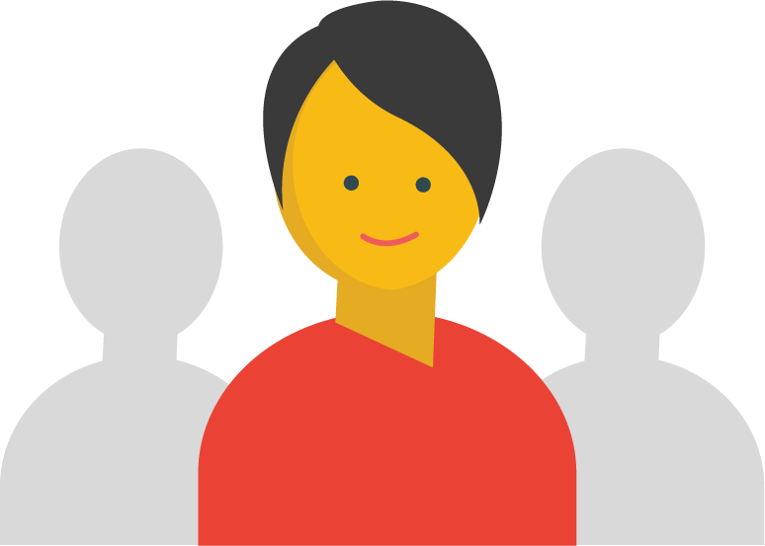

Process to Host a Cloud Fest
Register to host a Cloud
Fest
Request for
Event support*
Collaborate
Get students registered
Host
*Only events that run more
than 6 hours are supported
Please be sure to look for a venue that can accommodate attendees & also facilitate Internet connectivity. Ideally a lab.

Slide 6
Important sections of hosting
a Cloud Fest

Slide 7
Agenda
Topic one
1
Kickoff the event & describe the
Purpose of the event
2
Topic two
Tech talks, speaker sessions on stories or opportunities
Topic three
3
Hands-on Technical workshops / labs
Students Need to Complete 1 Quest during these Fests
4
Topic four
Questions & feedback!
Topic five
5
Wrap up! Never miss to say thanks!

Slide 8
Cloud Study Jams
Qwiklabs

Slide 9

Speaker Sessions
Opportunities

Slide 10

Meet, Greet!
Collaborate

Slide 11
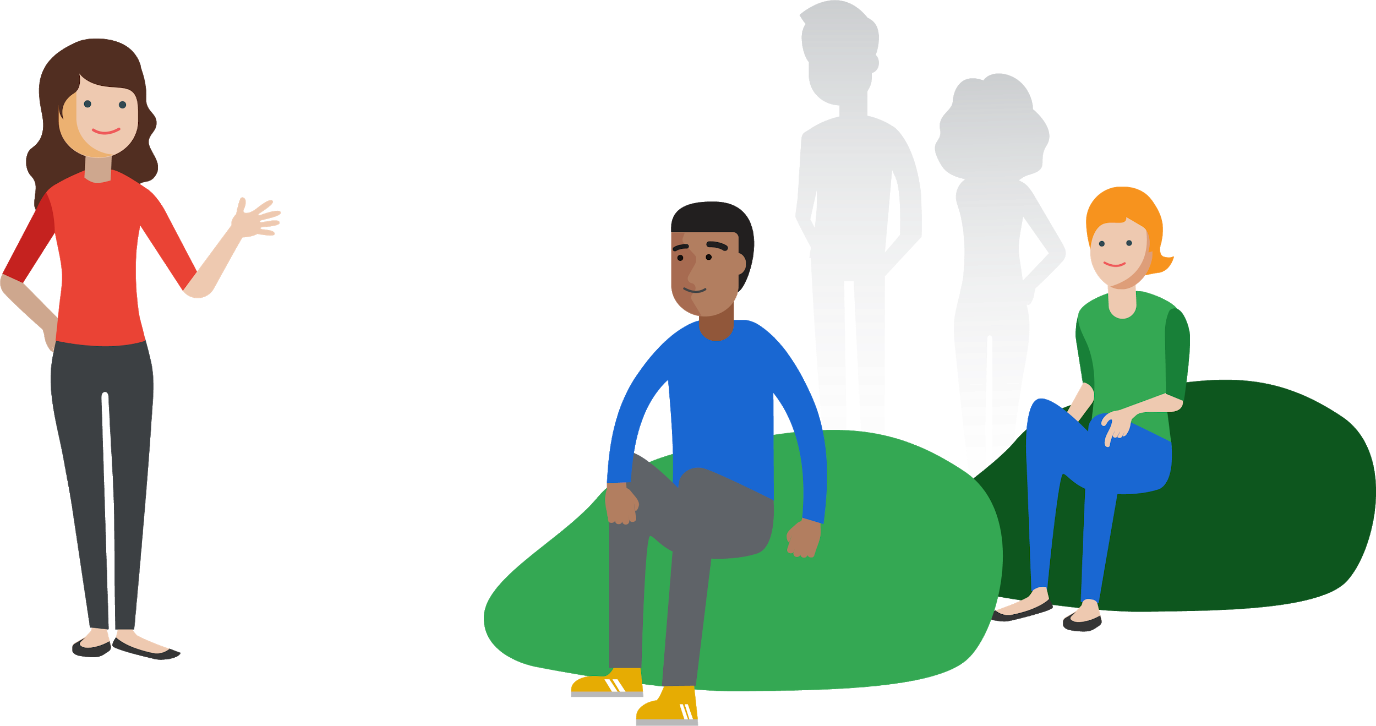

Open to All
Community

Slide 12

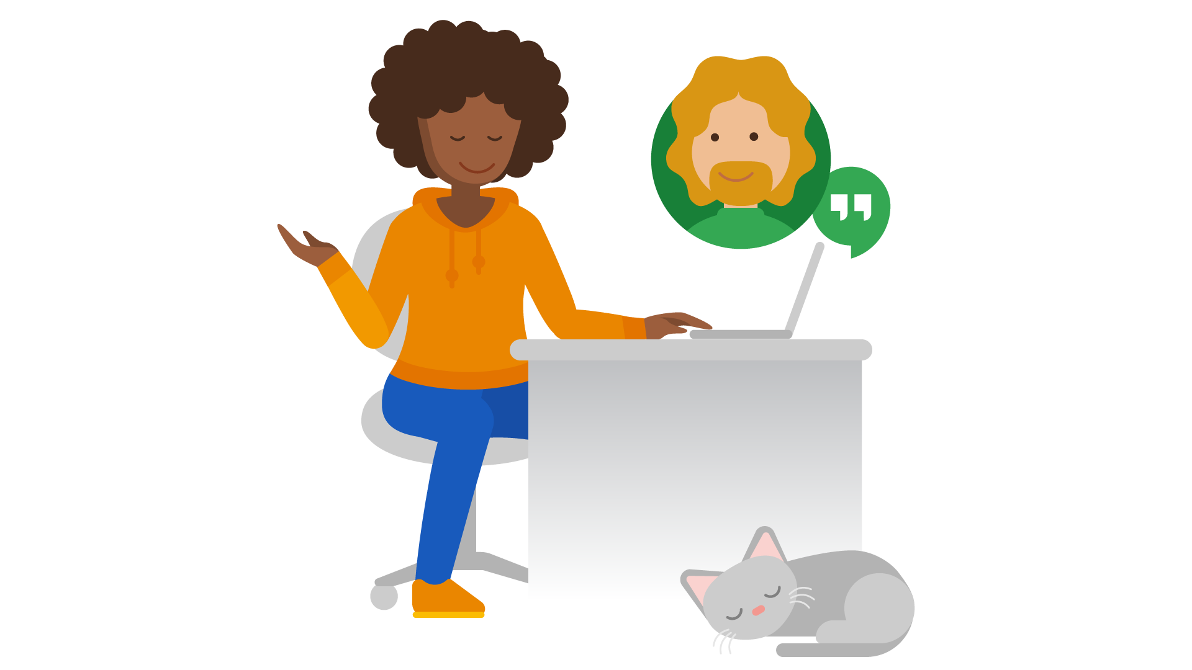
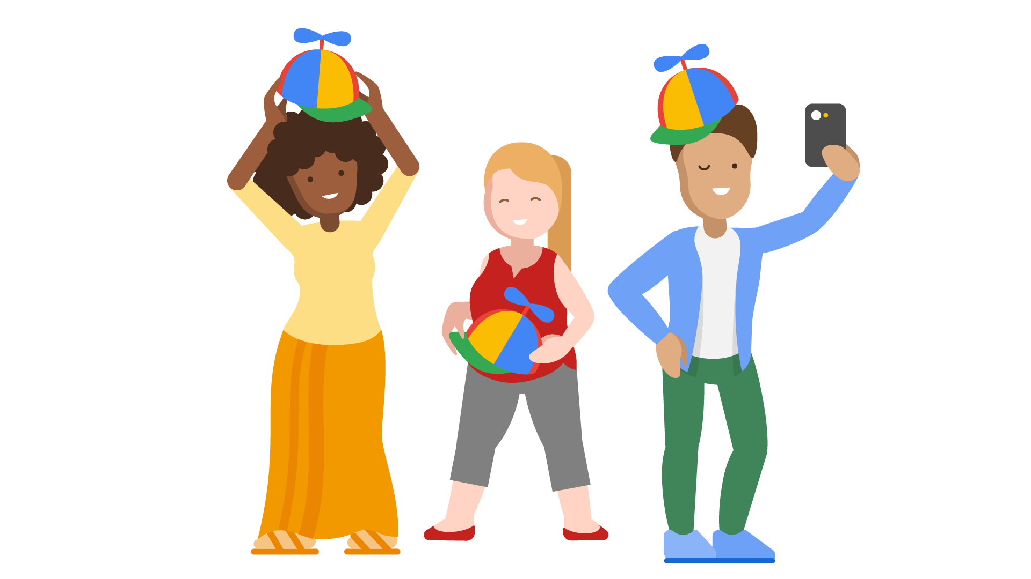
Attendee process
Register to a Cloud Fest
Cannot be any simpler! :p
Attend Workshops / Hands-on labs
At the venue
Take up Labs & Complete Quests!
Celebrate with Goodies

Slide 13
What do you need to do after the event?

Slide 14
Follow up on
DSC
Workshops & Labs

Slide 15




30 days to complete
Qwiklabs

Slide 16
Be the leader!
Show up your leadership abilities to host an event! Keep your
Audience aware about who you are and show the impact you
Are creating as a Community leader! Go pat your back!

Slide 17
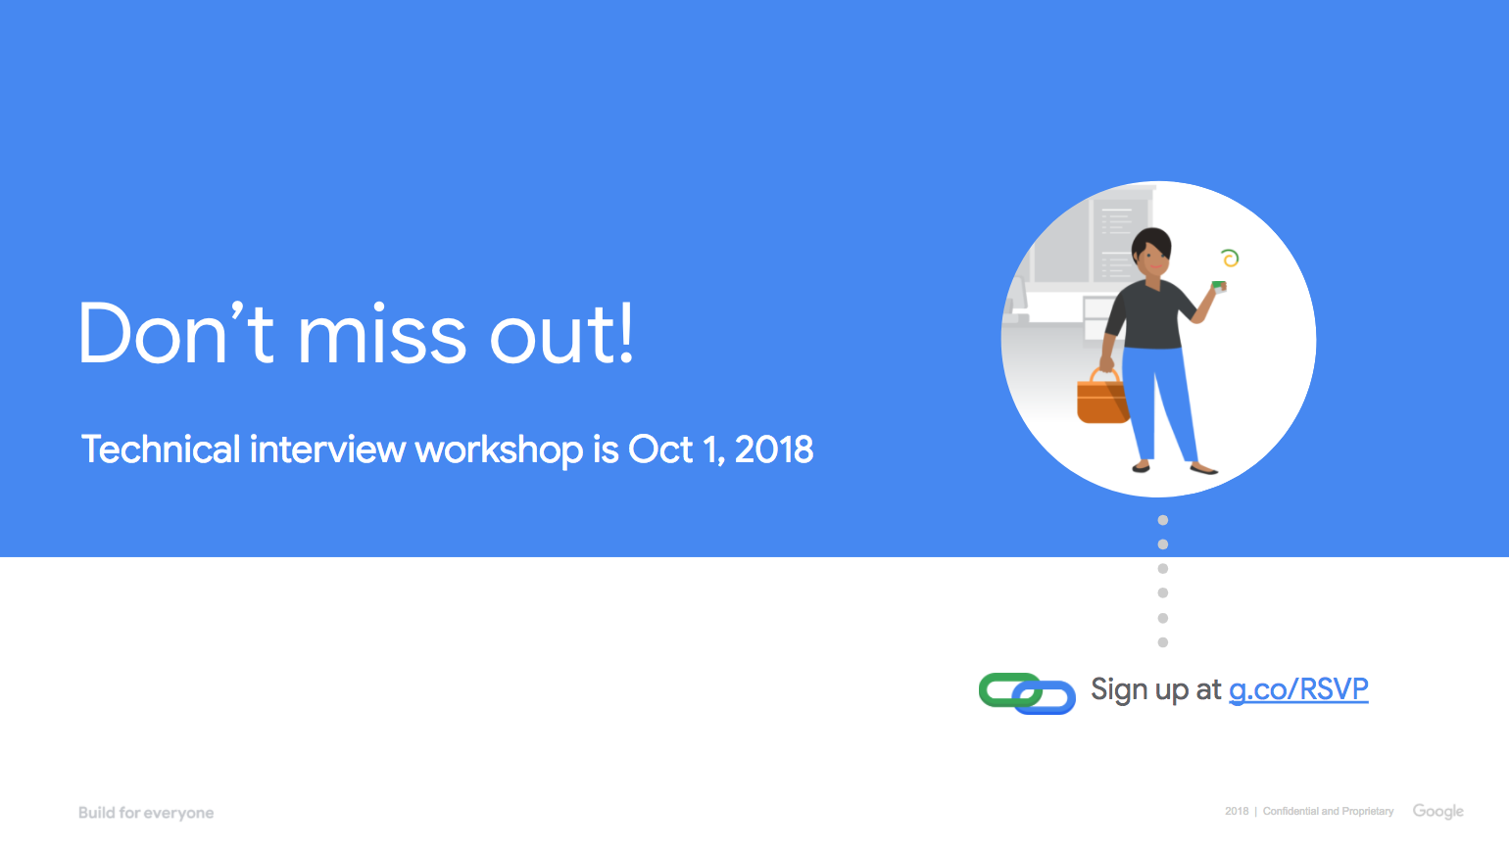
Tips to make a successful event
Do this
Be clear, be brief.
Follow up for feedback & completion of labs.
Collaborate with other Communities
Don’t do this
Make it an obligation to attendees.
Share more thoughts at once!

Slide 18

Let the world know!
Let your audience to keep sharing their
experiences at the event.
Always speak out
about your community
Tweet & share!
#developerstudentclubs #dscindia tag @googledevs and @googlestudents

Slide 19

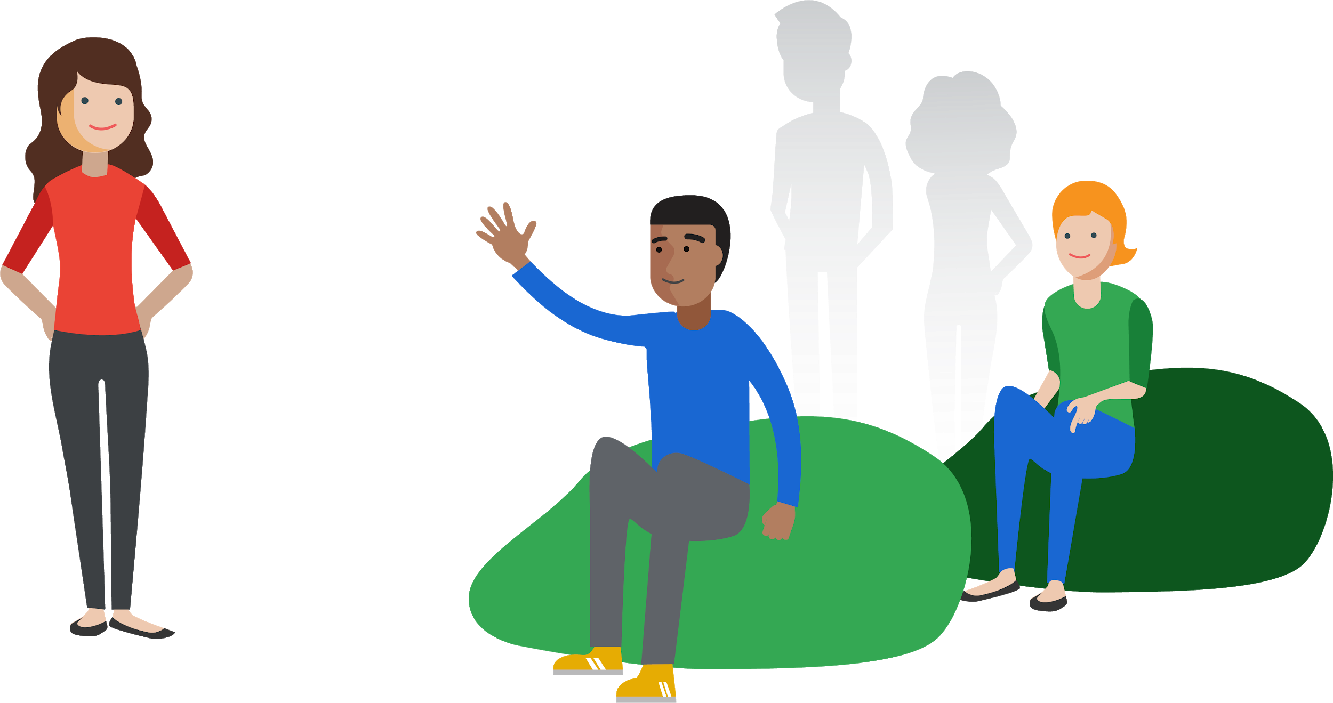
Thank you.
Questions?

Slide 20
#DSCCloudFest , #developerstudentclubs
#DSCIndia, #CloudStudyJams19,
#GoogleCloud
- Hashtags are superheros

Slide 21
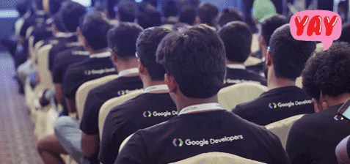
#DSCCloudFest
Learning lots and having fun at today’s event? Share with us! Tag and follow @GoogleDevsIN, @googlestudents on twitter.
#DSCCloudFest , #developerstudentclubs
#DSCIndia, #CloudStudyJams19,
#GoogleCloud

